Slide 1
CookIt iPhone App
Create, gather, and share your favorite recipes, which include detailed step-by-step instructions and scalable ingredient portion guides.
Presented By: Jordan Bartley

Slide 2
Project Description
Scalable Ingredients
Prepare and cook any recipe for any amount of guests.
Browse Global Recipes
Favorite Recipes
Create & Write Recipes
Share Recipes With Friends

Slide 3
Use Cases

Slide 4
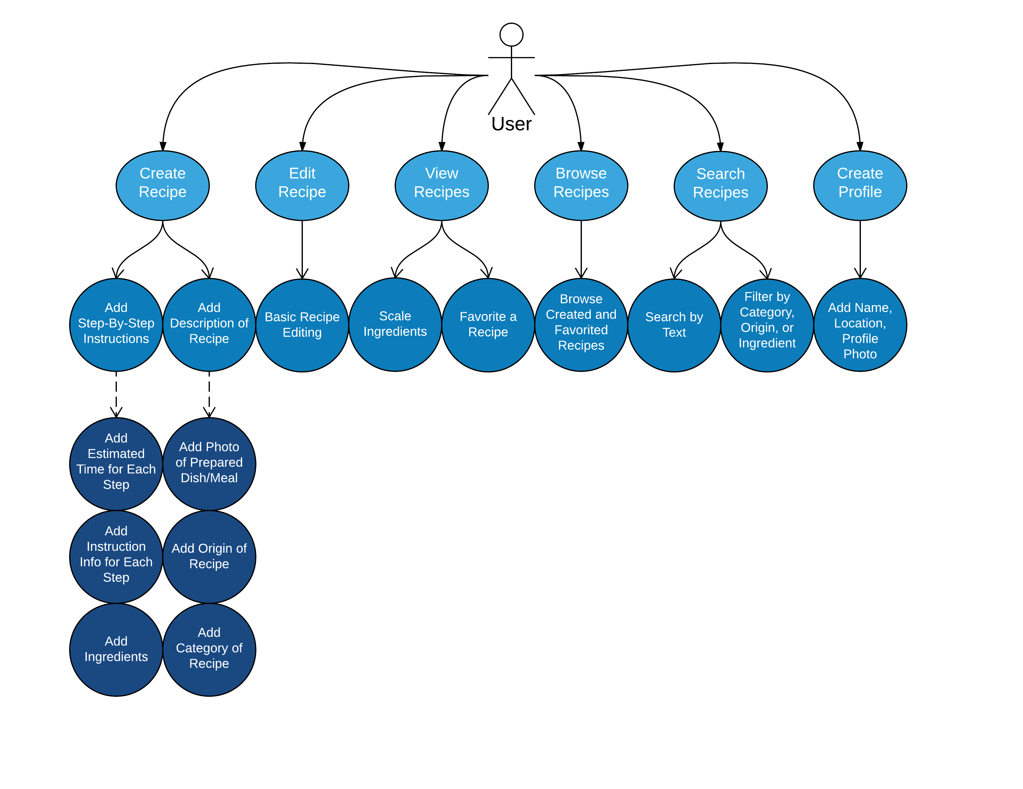

Slide 5

System Diagram

Slide 6
Project Demonstration

Slide 7
Future Work
Add photo and video capabilities to attach to recipes to help create clear and concise instructions.
Add “Spin-Off” recipes to instantly create a different version of an existing recipe.
Add access to the application through a website, so that if a large amount of recipes are to be added (such as from a cookbook), a user can quickly submit the information via the website rather than on their mobile device.
Create an Android version of the application.

Slide 8
Questions?
Thank you for taking the time to attend to this presentation about the CookIt iPhone Application.

